Slide 1
AZURE Machine Learning ADS Fall 17
Under the Guidance of :
Prof. Sri Krishnamurthy

Slide 2
Agenda
Intro to Azure ML
Setup free Azure account
Lab 1: Prediction Using Regression on Azure ML
Lab2: Classification on Azure ML
SVM & Boosted Decision Tree
Setup Web Service
Deploy & Consume this Model using API
In Class Streaming Analytics PPT (Team 5)

Slide 3
INTRO to Azure
AZURE
https://docs.microsoft.com/en-us/azure/machine-learning/studio/data-science-for-beginners-the-5-questions-data-science-answers

Slide 4
LAB 1: Prediction using Regression
Step 1: Get the Data- Automobile price data
Step 2: Prepare The Data (Cleaning)
Step 3: Feature Selection
Step 4: Train the model (Linear Regression)
Step 5: Score & Evaluate the model
Step 6: Repeat steps 3-5 to improve the model. (Optional)

Slide 5
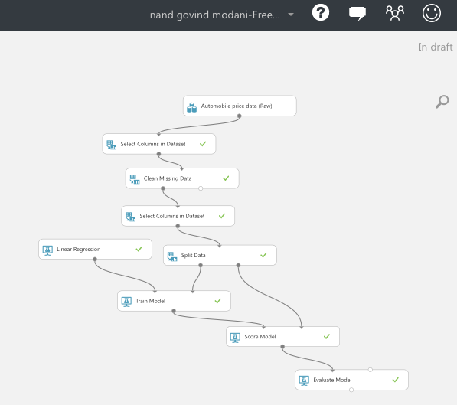
Final Azure Model

Slide 6
LAB 2: Classification
Step 1: Upload Data
Step 2: Prep the Data (also how to use R script in Azure)
Step 3: Train the data (Intro to SVM)
Step 4: Evaluate Models
Step 5: Set up Web Service
Step 6: Access Web Service
Notes:
sed 's/ /,/g' german.data > german.csv
cat german.data | %{$_ -replace " ",","} | sc german.csv

Slide 7
Intro to SVM
Support Vector Machines (SVMs)
A Supervised Learning Technique
High Level Overview of SVM
https://www.youtube.com/watch?v=Y6RRHw9uN9o
https://www.slideshare.net/analog76/support-vector-machine-27602310

Slide 8
What Does SVM DO?
A support vector machine constructs a hyperplane or set of hyperplanes in a high- or infinite-dimensional space, which can be used for classification, regression, or other tasks. Given a set of data points that belong to either of two classes, an SVM finds the hyperplane that:
Leaves the largest possible fraction of points of the same class on the same side.
Maximizes the distance of either class from the hyperplane.
Find the optimal separating hyperplane that minimizes the risk of misclassifying the training samples and unseen test samples.

Slide 9
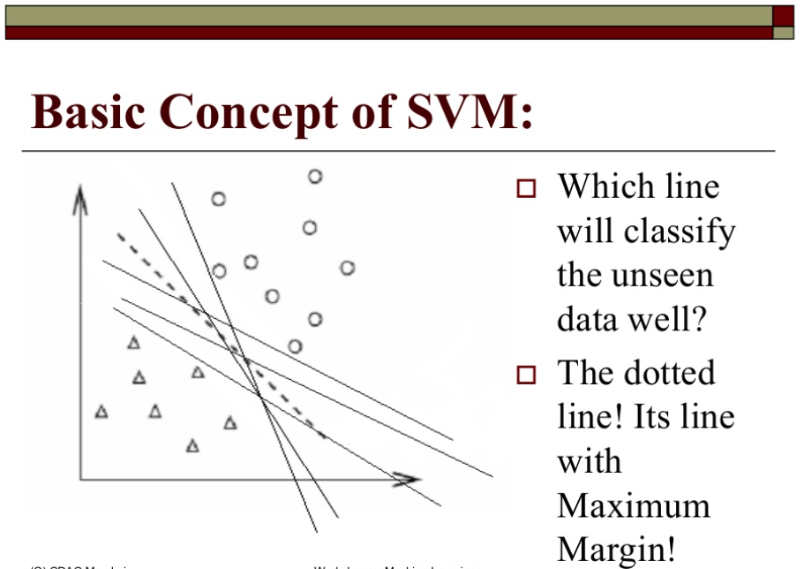

Slide 10
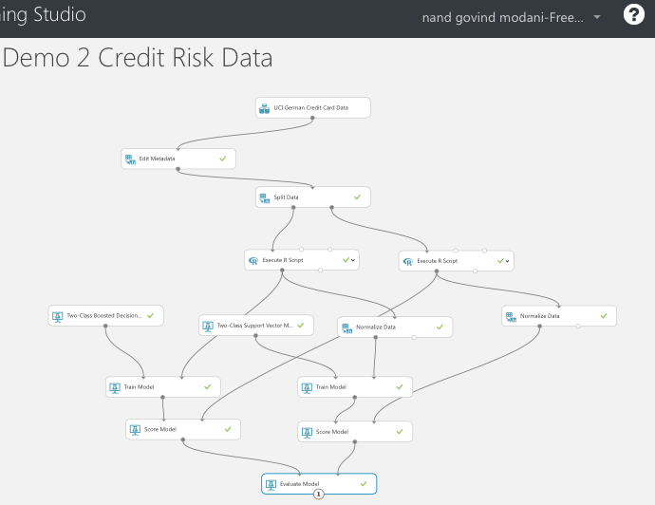
Final Azure Model

Slide 11
Further Practice Material
Try these tutorials
http://gallery.cortanaanalytics.com/Experiment/Tutorial-for-Data-Scientists-3
http://gallery.cortanaanalytics.com/Notebook/Tutorial-on-Azure-Machine-Learning-Notebook-1
http://gallery.cortanaanalytics.com/Notebook/Deployment-of-AzureML-Web-Services-from-Python-Notebooks-4
Classification:
http://gallery.cortanaanalytics.com/Experiment/Tutorial-Building-a-classification-model-in-Azure-ML-8
Regression :
http://gallery.cortanaanalytics.com/Experiment/Regression-Demand-estimation-4
Clustering :
http://gallery.cortanaanalytics.com/Experiment/Clustering-Find-similar-companies-6
Recommendation Systems
https://mva.microsoft.com/en-US/training-courses/building-recommendation-systems-in-azure-13765?l=j6AfbmlXB_4505513172

